Slide 1
Thesaurus Musicarum Germanicarum and the "Law of the Stimulative Arrears" ? Christophe Guillotel-Nothmann
TMG Seminar-Workshop, April 22nd 2016

Slide 2
1. Project’s aims, outcomes and challenges
Main objectives
Improve access to music-theoretical sources published between 1474-1650 in German speaking lands, by providing electronic editions with a highly differentiated TEI/MEI encoding:
Identify the document’s structure
Normalize typography, abbreviations and punctuation
Encode musical examples and tables
Identify persons, works, places and musical terminology
Encode textual, musical and iconographical citations
Outcomes
Improve the understanding of music theories and practices
Scrutinize how these sources interact with (evolving) rhetorical, philosophical, physical and acoustical models
Give insights in the circulation of knowledge in Early Modern Europe
Investigate social, political and religious underpinnings of musical knowledge

Slide 3
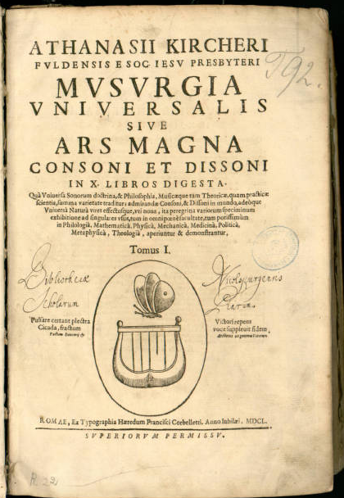
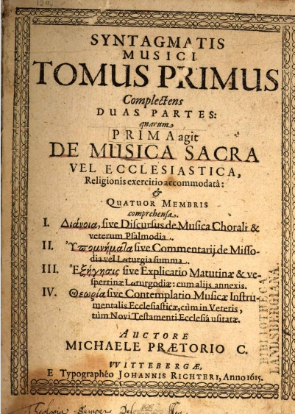
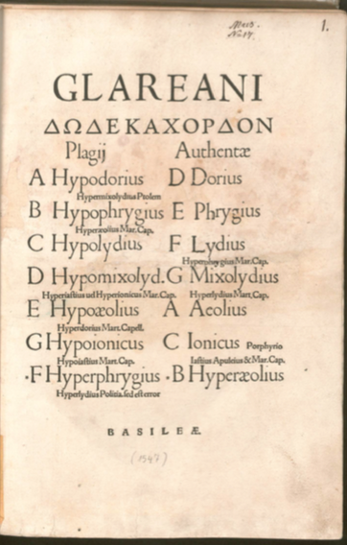
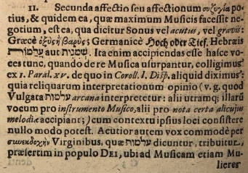
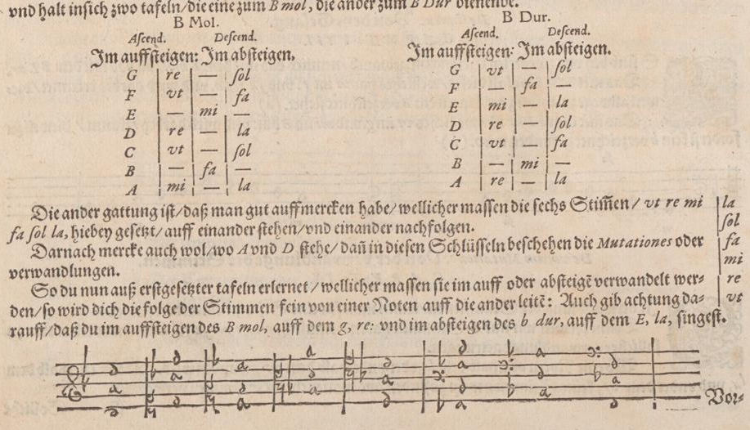
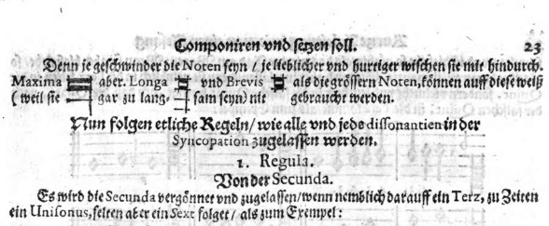
1. Project’s aims, outcomes and challenges
Challenges
Volume : 340 sources, some of great density
Glarean (1547): 505 p.
Praetorius (1615-20): 518 p. + 272 p. + 288 p.
Kircher (1650) : 750 p. + 534 p.
Etc.
Typographical, linguistic and philological complexity
Fraktur and Antiqua fonts, special (musical) characters
German, Latin, Greek texts
Abbreviations, punctuation and orthography (medieval Latin and New Latin)
Contents
Trimedial sources: text, music and tables
Music-theoretical complexity
Interaction with other disciplines
Herbst (1643), 23.
Anonymus Exerpta(c. 1496), A4 r.
Treu (1645), C3 v.
Mareschal (1589), 12.
Praetorius (1615), vol. I, title page.
Kircher (1650), vol. I, title page.
Glarean (1547), title page.

Slide 4
2. Methodological approach
The dilemma: deep encoding or large corpus?
The corpus’ volume and complexity are not compatible with a deep encoding of all sources in a reasonable amount of time (3-5 years)
Should we limit the depth of investigation or the width of the corpus?
Pro depth: The project aims at providing assistance in reading, investigation and interpretation of the sources – a deep encoding is necessary for that purpose
Pro width: The strength of digital humanities lies in the serial analysis of large corpora – the restriction to “case studies”, individual “schools” or “persons” would partly neglect the potential of electronic edition
A compromise has to be found, reconciling both perspectives by taking into account the specificities of both the corpus and the electronic edition
All texts do not have the same theoretical importance and cultural-historical significance
The encoding needs and methods vary according to the sources’ specificities, the questions raised and the schedule of the project
The choice of the texts and the encoding applied should depend on the intrinsic knowledge of the sources and not only on historiographical assumptions (important names, forgotten small masters etc.) – this requires a thorough investigation of the corpus

Slide 5
2. Methodological approach
Possible solution: a modular and explorative approach
Unlike paper editions, electronic editions are not final, they can be progressively enriched
Apply a standard encoding, common to all sources ”main corpus”
Apply a deep encoding to some sources selected according to different criteria and gathered in a “core corpus”
Prior historical and theoretical knowledge
Accessibility (former paper or electronic editions) and state of research
Knowledge and insights gained from the investigation of the main corpus
The balance between the main corpus and the core corpus can be readjusted according to different criteria:
The investigation of both corpora
The project’s schedule
The initiatives in subsequent projects
The modular and explorative approach questions the status of both the editor and the edition
Multiple editors
Multiple editorial strata
Core corpus
Main corpus

Slide 6
2. Methodological approach
Possible solution: a modular and explorative approach
Encoding | Task | Status | Corpus
Flat text | Transcription | red | main
Typography, abbreviation, punctuation | Normalization | orange
Hyphenation
Text structure | Segmentation
Tables |  | yellow | core
Musical examples
Additions, deletions and corrections | Interpretation | green
Persons, works, places, musical terminology
Citations

Slide 7
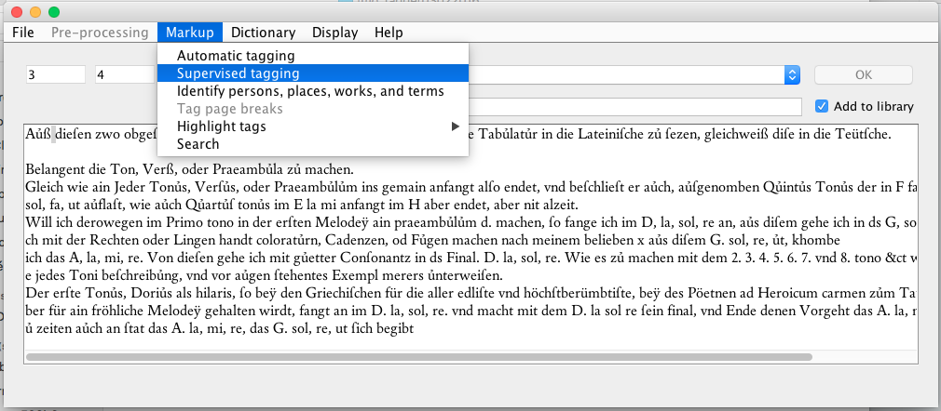
3. Encoding tools and techniques
TMG_</Tagger>:
Created to reduce the time needed to encode the texts and to help researchers in humanities create with minimal technical background and maximal ergonomics a TEI document according to their needs
Developed in Java (JDK 8) during the preliminary phase according to the problems and encoding needs encountered
Implements different libraries (tags, persons, places etc.) and several encoding and detection algorithms
Focussed currently on low-level units (characters, words) and extended in the medium term to take into account higher hierarchical units
TMG_</Tagger>, main window.

Slide 8
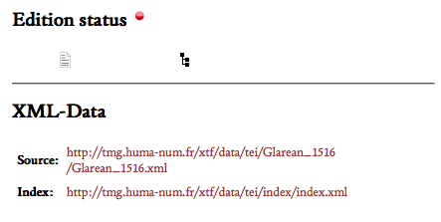
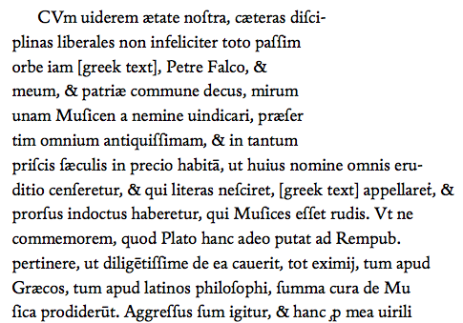
3. Encoding tools and techniques
1. Transcription
OCR software specialized in the Fraktur fonts does not provide the quality of restitution expected
Double-key transcriptions of the sources provided by the Kompetenzzentrum Trier (99,95% accuracy)
The special characters found in the sources are encoded in TUSTEP notation (TUebingen System of TExt processing Programs), which has to be converted to Unicode:
Example: Glarean, Isagoge (1516).

Slide 9
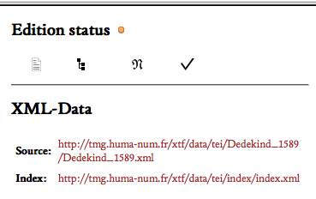
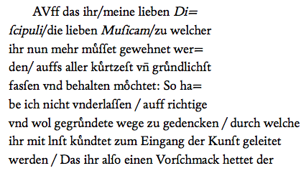
3. Encoding tools and techniques
2. Normalization
Typography and abbreviations are encoded semi-automatically with the tagger according to a specific algorithm
Punctuation is encoded semi-automatically
Automatic replacements for “/” ⟹ “,”
Editor’s intervention for contextual choices “;” or “,” etc.
Hyphens are encoded automatically
Example: Dedekind, Eine Kinder Music (1589).
Token analysis
Character and abbreviation library
Generate tag
Wait for user validation
Add tag to library
Token is in tag library
Token is not in tag library
Encode token with tag
Encode token with tag

Slide 10
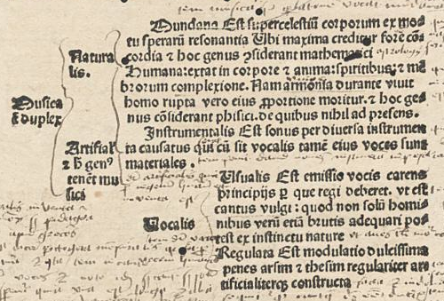
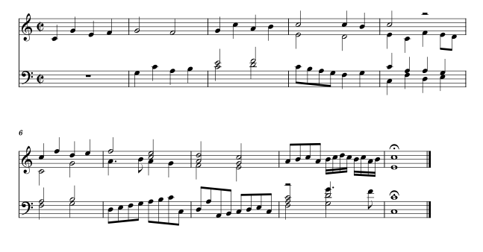
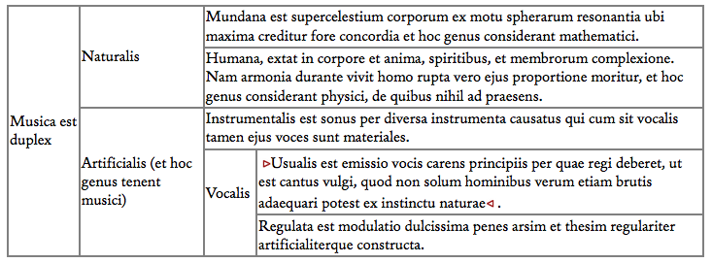
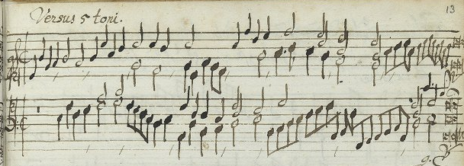
3. Encoding tools and techniques
Segmentation
Text
Current state: Encoded with a conventional xml editor
Future improvements: Development of TMG_tagger to take into account higher hierarchical levels
Tables
Edited in Excel
Converted to TEI via OxGarage Conversion
Musical examples
Edited in Finale
Converted to MEI (via MusicXML) with XSLT scenarios (University of Paderborn)
Proofread and enriched with MEISE editor (University of Paderborn)
A real need remains for integrative IT tools facilitating the encoding and the editing of non-textual parts: tables, schems and musical examples
Anonymous, Instrumentälischer Bettlermantl, 13 r.
Anonymous Exerpta (1496), A4 r.

Slide 11
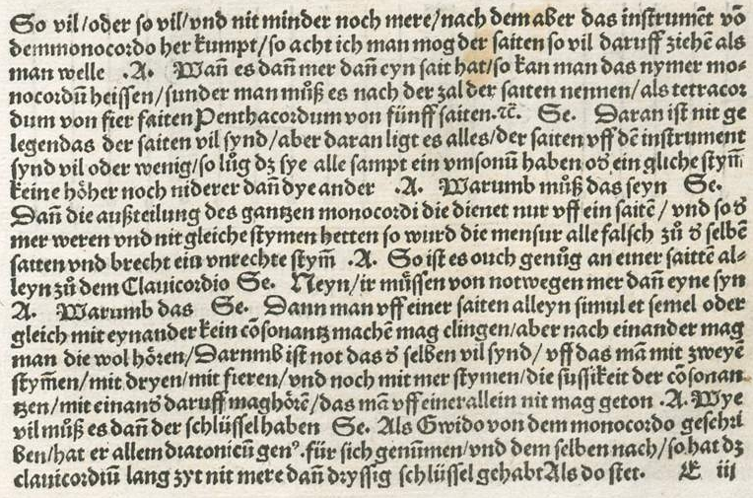
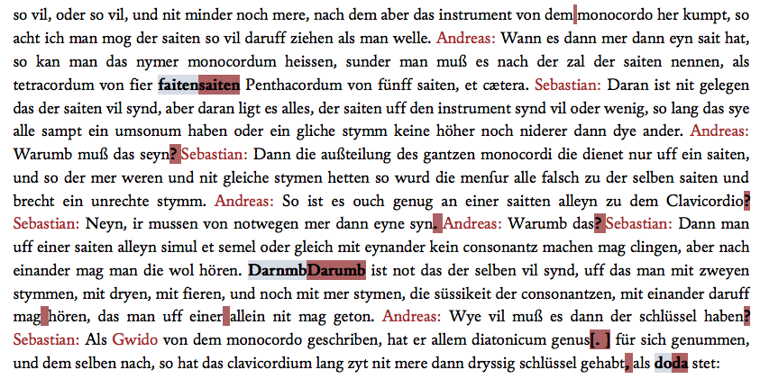
3. Encoding tools and techniques
Interpretation
Critical edition: Additions, Deletions, Corrections
Current state: Encoded with a conventional xml editor
Future improvements: Development of TMG_tagger to take into account higher hierarchical levels
?
?
?
?
?
Example: Virdung, Musica getutscht (1511), E3 r.

Slide 12
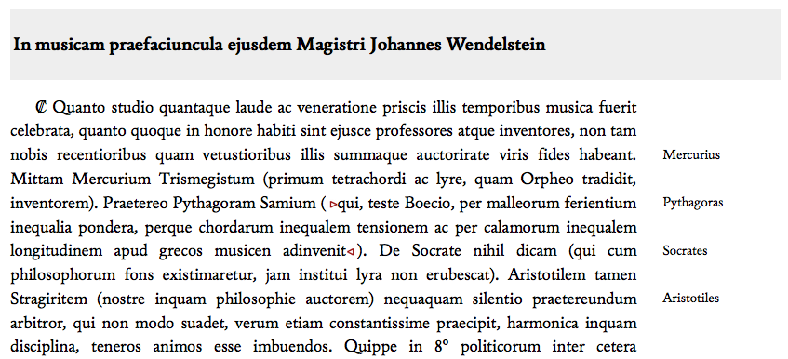
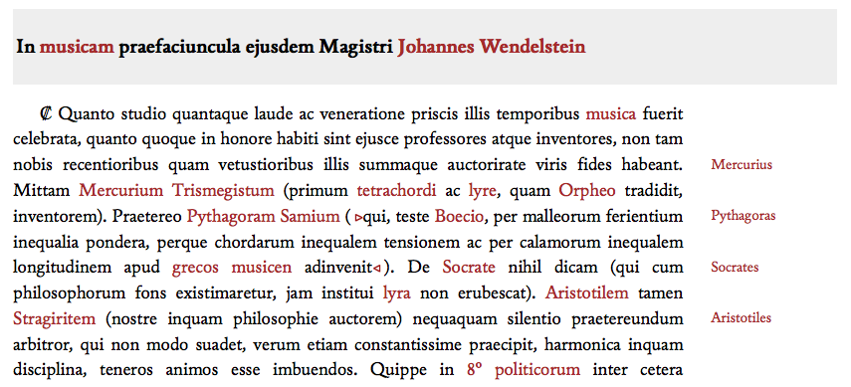
3. Encoding tools and techniques
Token analysis
Person, work, place, term library
Token analysis
Token is in the library
Encode toke
Token is not in the library
Generate tag and highlight token
Wait for user
validation
Encode token with tag
Add tagg to library
Add person, work, place, musical term to library
Interpretation (continued)
Identification of persons, works, places, and musical terms with the tagger according to a specific algorithm:
Example: Cochlaeus, Musica (1507), A1 v.

Slide 13
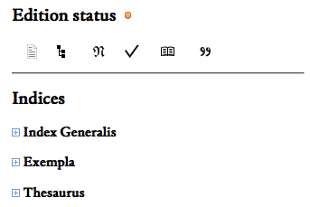
3. Encoding tools and techniques
Interpretation (continued)
Citation analysis
Current state: Bibliographical identification and encoding with a conventional xml editor (text, music, iconography)
Further improvement
Textual units: Tracer software for historical text reeuse (eTrap, Göttingen Center for Digital Humanities)
Identify systematically text reuse within the the corpus and between TMG and other databases (TML, TMI, TRéMIR etc.)
Encode citations
Musical units: Neuma database for the analysis of musical citations
Example: Cochlaeus, Musica (1507), A1 v.

Slide 14
Conclusions
The preparatory phase (since September 2015) has given valuable hints on how to improve the project’s workflow
The tagger developed during the last months significantly contributes to the increase of the encoding speed and ergonomics
Normalization (typography, abbreviation, punctuation, hyphenation)
Identification (persons, works, places, musical terms)
Some encoding tasks remain time-consuming and will benefit from additional tools
Encoding of non textual parts (tables, musical examples)
Interpretation (citations, editorial interventions)
The modular approach gives promising results
Highly adaptive with respect to the source’s specificities and to the different editorial situations encountered
Allows a progressive enrichment of the editions

